Slide 1
Holistic Approach to Diabetes Risk Prediction
Final Programming Project
Presented by : Krittika, 1st year MOB Graduate Program (1st Dec, 2020)

Slide 2
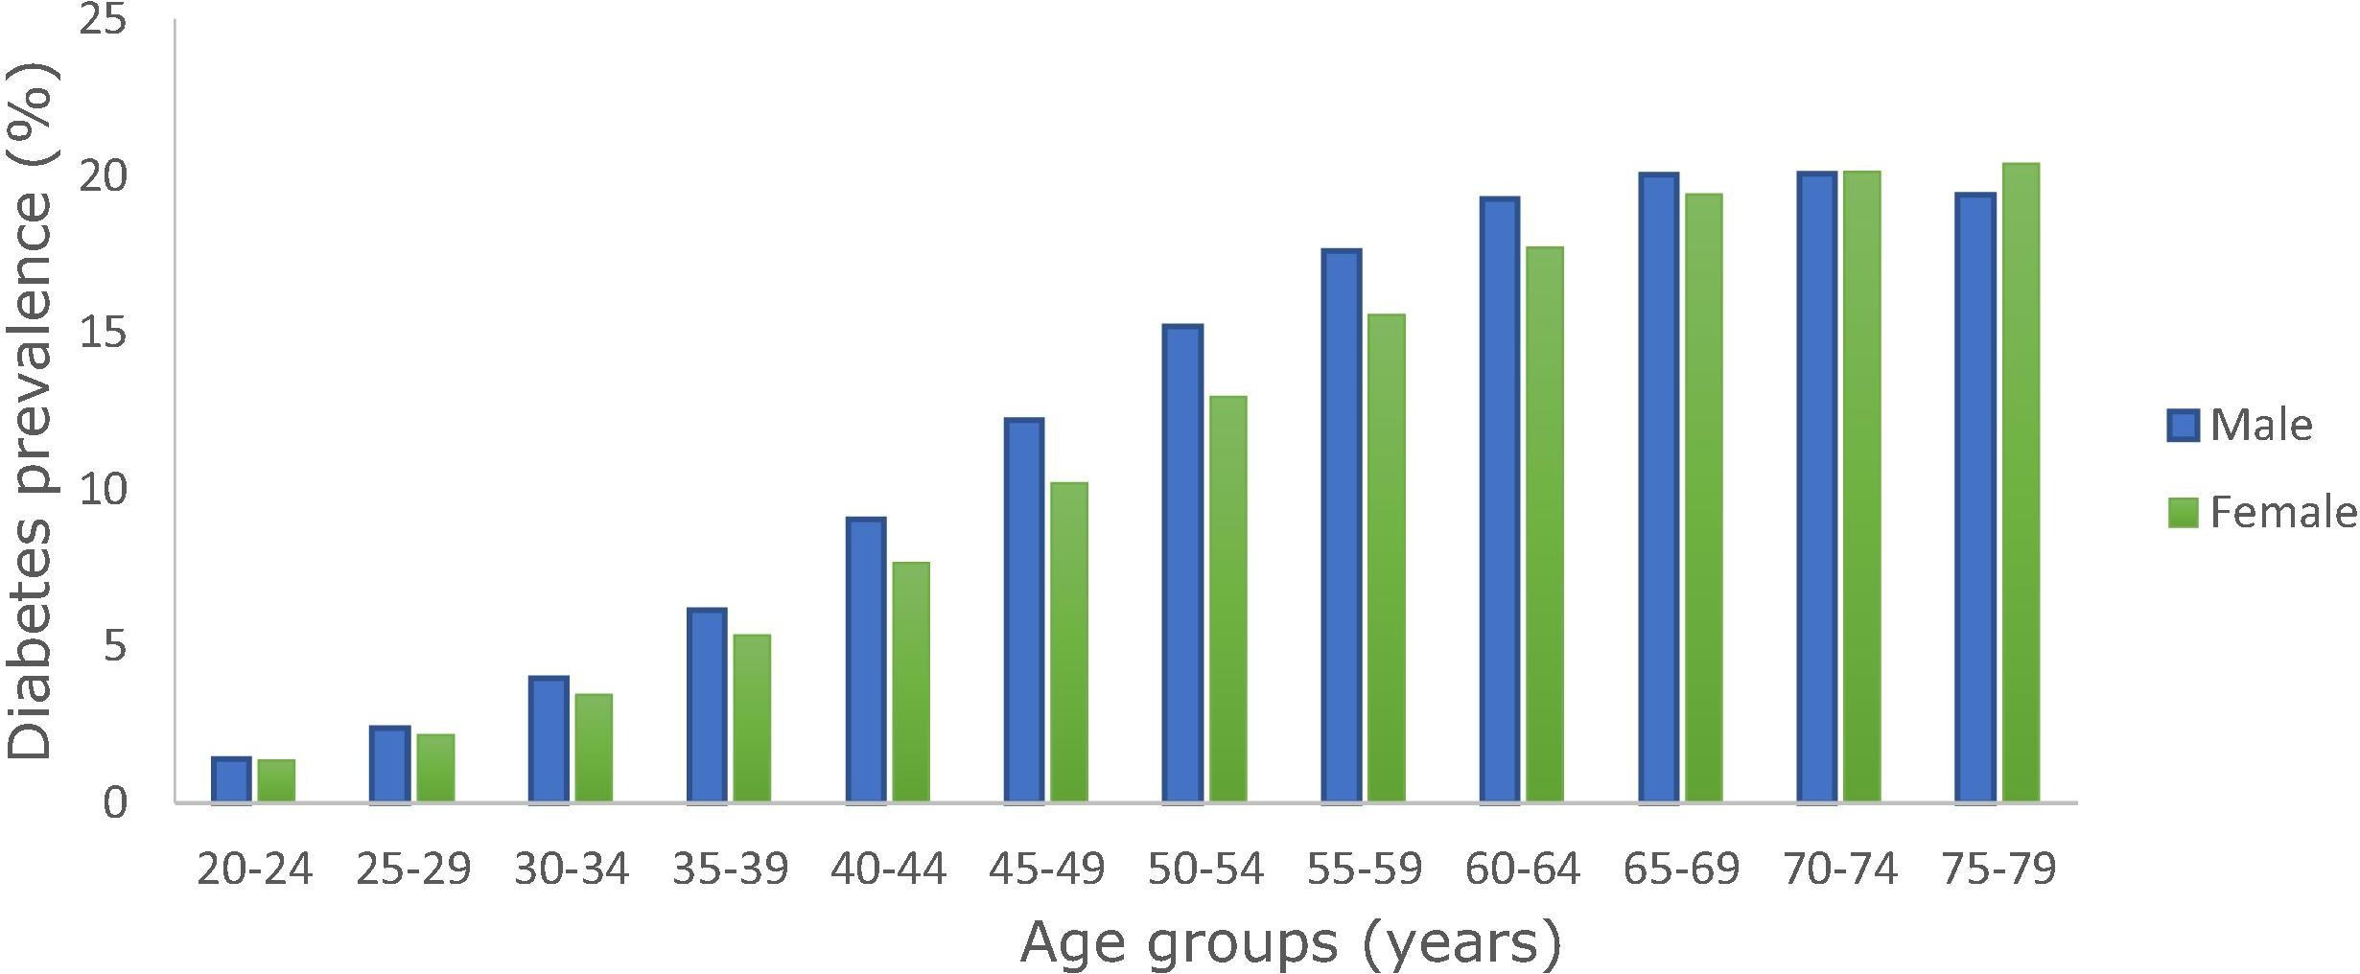
Just under half a billion people are living with diabetes worldwide and the number is projected to increase by 25% in 2030 and 51% in 2045.
https://doi.org/10.1016/j.diabres.2019.107843

Slide 3
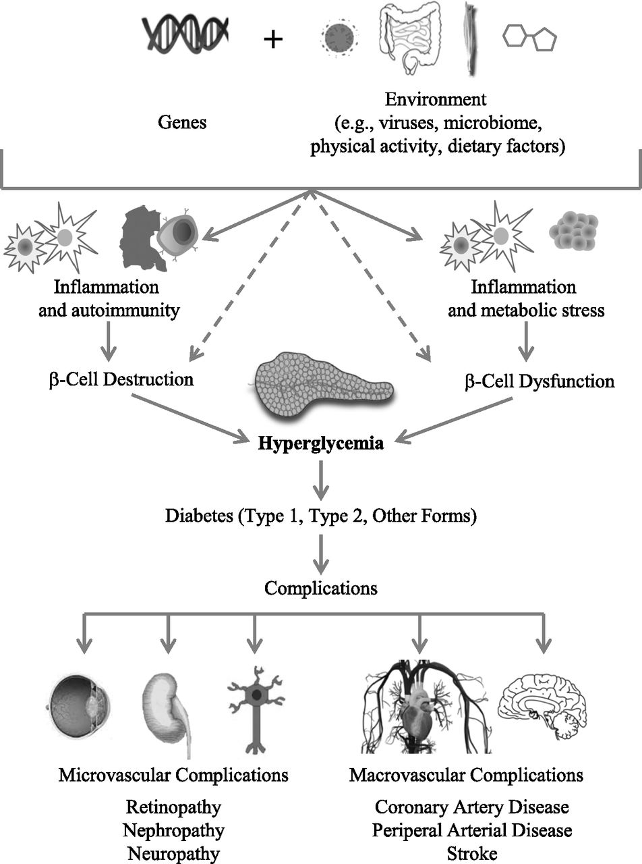
Pathophysiology of Diabetes Mellitus
https://diabetes.diabetesjournals.org/content/66/2/241

Slide 4
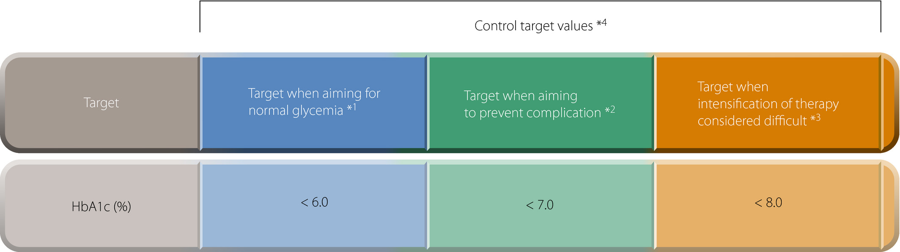
Typical Diabetes Detection Protocol
https://onlinelibrary.wiley.com/doi/full/10.1111/jdi.12810

Slide 5
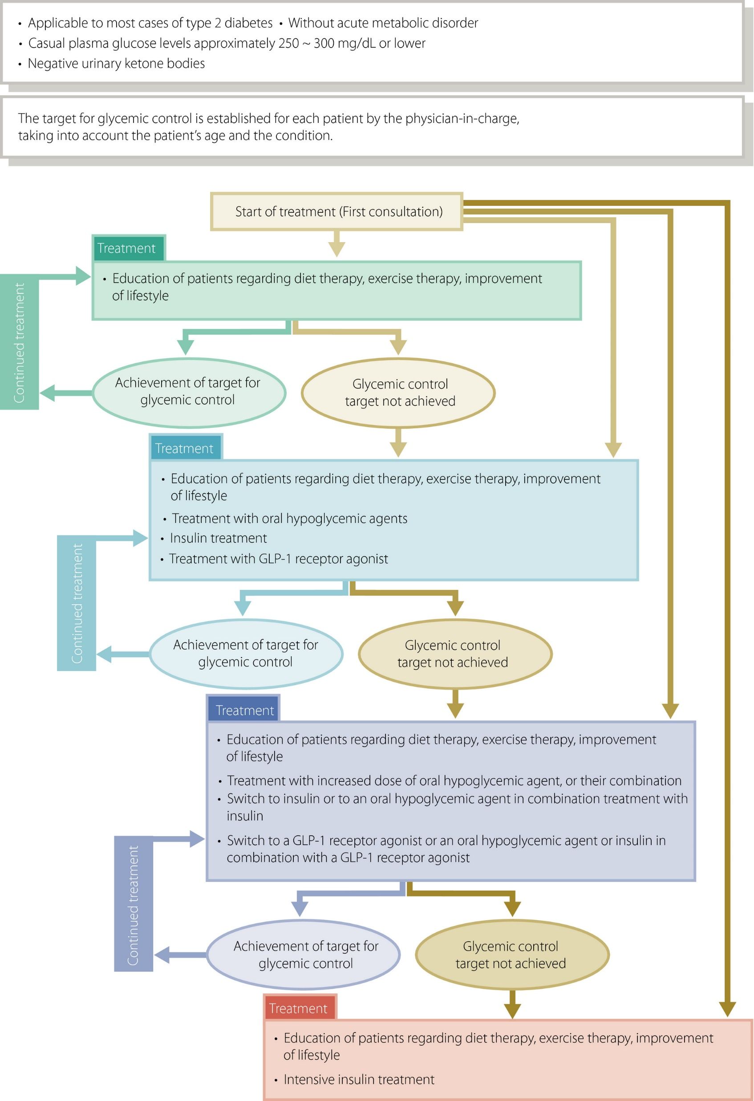
Proposed Treatment Plans https://onlinelibrary.wiley.com/doi/full/10.1111/jdi.12810

Slide 6
Dataset I
Dataset II
Dataset III
Number of Pregnancies
Glucose Level
Blood Pressure
Skin Thickness
Insulin
BMI
Diabetes Pedigree
Age
Age
Gender
Polyuria
Polydipsia
Sudden Weight Loss
Weakness
Polyphagia
Genital Thrush
Visual Blurring
Itching
Irritability
Delayed Healing
Partial Paresis
Muscle Stiffness
Aloepecia
Obesity
Exposure to medication drugs like metformin, glyburide, etc and no. of medications
Insulin levels
HbA1c %
Readmission Rate

Slide 7
Use of different Statistical Algorithms to predict chances of occurrence
Logistic Regression
Random Forest
Naïve Bayes
Gradient Boosting
KNN
Neural Network
Support Vector Machine

Slide 8
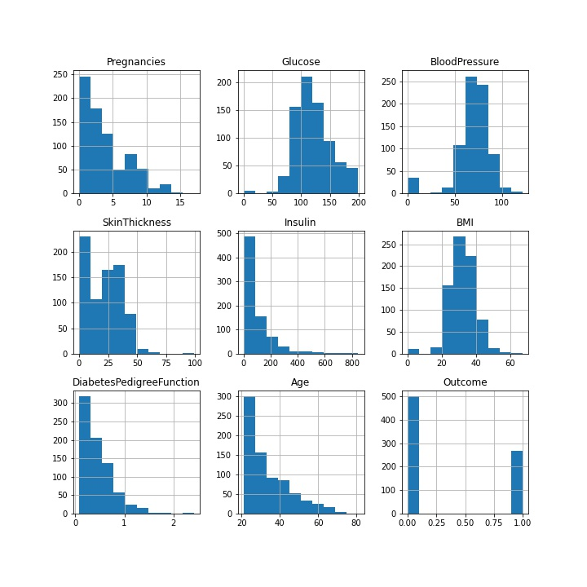
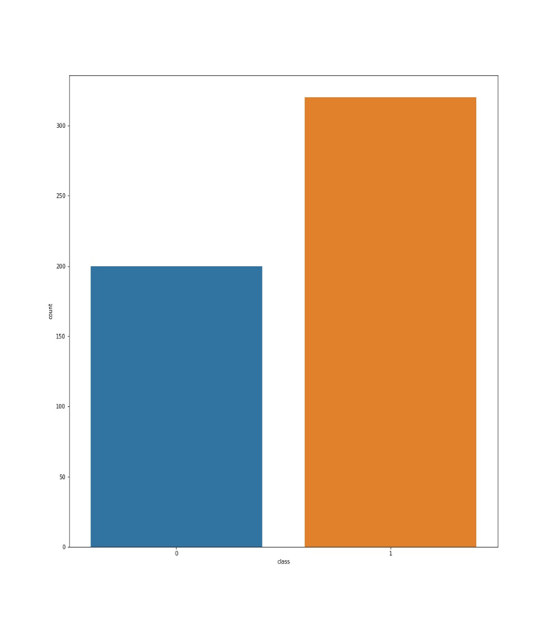
Dataset I
Dataset II

Slide 9
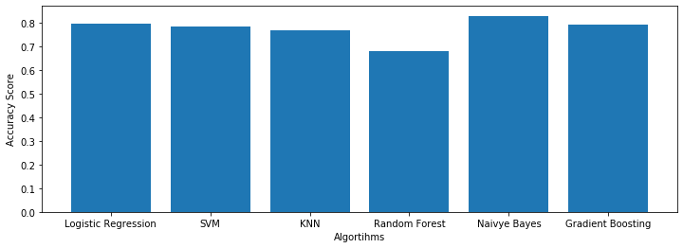
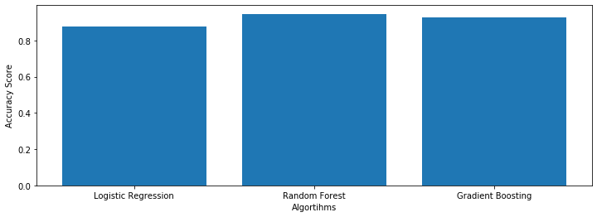
Accuracy Comparison of Algorithms
Dataset I
Dataset II

Slide 10
Why is diabetes risk modelling important?
Diabetes is often associated with renal complications, heart disease, stroke and peripheral vascular disease, which lead to increased morbidity and premature mortality.
Growing healthcare burden will present an overwhelming challenge in terms of health service resources.
Risk prediction models have considerable potential to contribute to the decision-making process regarding the clinical management of a patient.
They are multivariable, combining several patient risk predictors that are used to predict an individual's treatment outcome so that healthcare interventions or lifestyle changes can then be targeted towards those at an increased risk of developing a disease.
These models can also be to screen individuals to identify those who are at an increased risk of having an undiagnosed condition, for which diagnosis management and treatment can be initiated and ultimately improve patient outcomes.
https://bmcmedicine.biomedcentral.com/articles/10.1186/1741-7015-9-103

Slide 11
THANK YOU!

